Slide 1
Sampling Methods

Slide 2
Sample
A sample is a Subset of the population.
A sample is a smaller set of data that a researcher chooses or selects from a larger population using a pre-defined selection bias method. These elements are known as sample points, sampling units, or observations.
Sampling units are nonoverlapping collections of elements from the population that cover the entire population.

Slide 3
Population ?
The population includes all members of a
specific group.
Entire Dataset.
Population can be defined as the total number of individuals, whether human, animal, plant, or microorganism, residing in a specific area or ecosystem.

Slide 4
Why sample?
The population of interest is usually too large to attempt to survey all of its members.
A carefully chosen sample can be used to represent the population.

Slide 5
Probability versus Nonprobability
Probability Sampling Every member of the population has equal chance of being selected for research.
Methods include random sampling, systematic sampling, and stratified sampling,cluster sampling.
Non-Probability Sampling Every member of the population has not equal chance of being selected for research.
Methods include convenience sampling, judgment sampling, quota sampling, and snowball sampling

Slide 6
Simple Random Sampling
Simple Random Sampling is a probability sampling method.
In this technique every member of the sample is selected purely random basis with equal chance.
Picking chits from bowl, lottery system, random number generator etc. are the methods of simple random sampling.. .

Slide 7
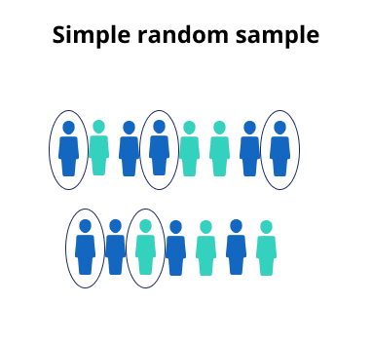
Simple Random Sampling Example:

Slide 8
Systematic Sampling
In this technique population is arranged in ascending or descending order, then researcher randomly picks first items from population.
Sampling interval=total population/sample size=1000/100=10
Suppose first number picked by researcher is 7, the next will be 7+10=17, next will be 17+10=27, 27+10=37 and so on.

Slide 9
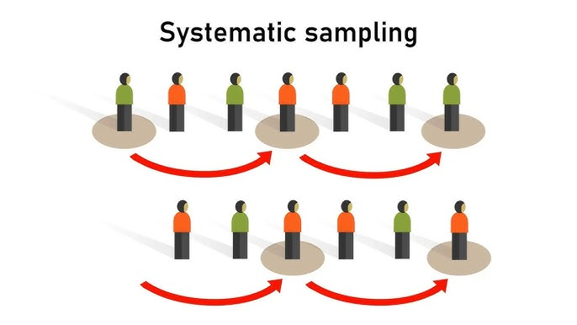
Systematic Sampling Examle:

Slide 10
Stratified Sampling
Stratified sampling is commonly used probability method that is superior to random sampling because it reduces sampling error.
A stratum is a subset of the population that share at least one common characteristic; such as males and females.
In this technique population is divided into mutually exclusive groups, and then every member of the group has equal chance of being selected for research.

Slide 11
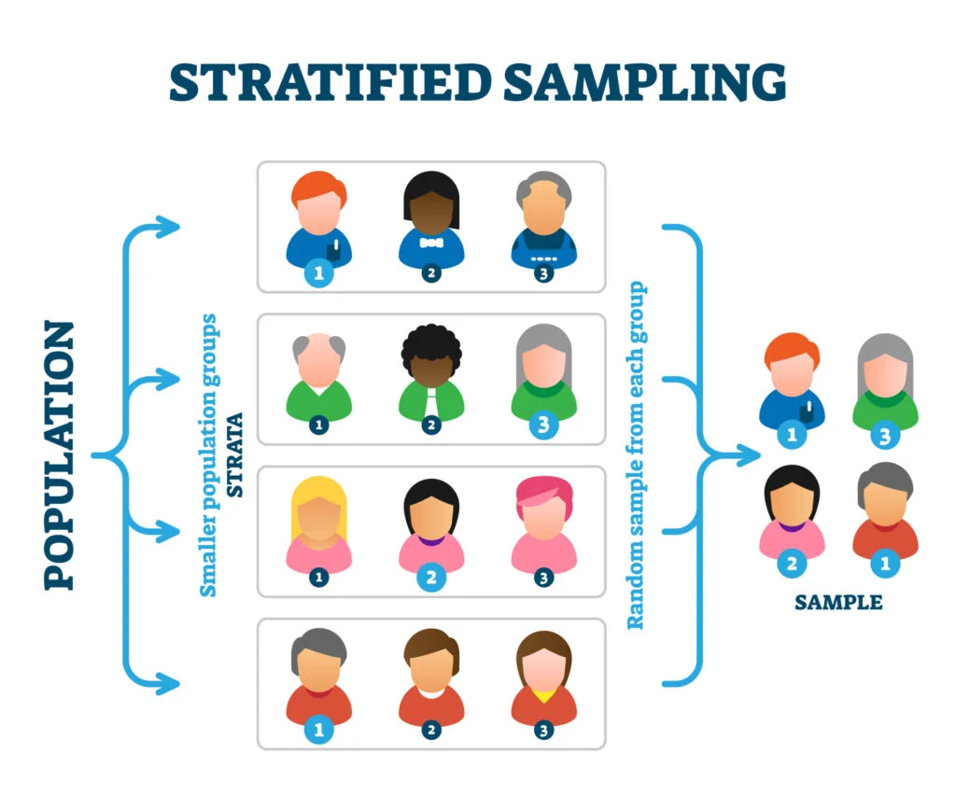
Stratified Sampling

Slide 12
Cluster Sampling
This technique is used when large population (geographically dispersed) is under study. Whole population is divided into small groups which is called clusters.
For example a company want to study the performance of a particular product in the country. The country is divided into cluster (cities, towns, metropolitan areas etc.)

Slide 13
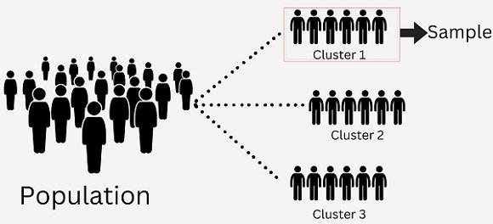
Cluster Sampling

Slide 14
Convenience Sampling
Convenience sampling is also called grab sampling, availability sampling, accidental sampling etc.
-It is type of sampling in which data is collected from the "conveniently available respondents".
-It is low cost and fast sampling technique.

Slide 15
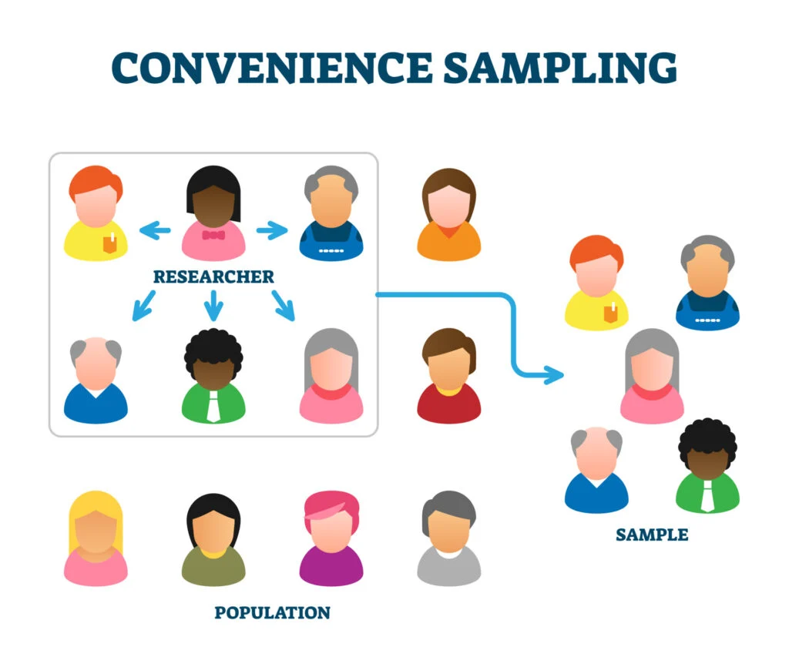
Convenience Sampling Example:

Slide 16
Judgment Sampling
It is also called authoritative sampling, selective sampling, subjectiv sampling.
• It is a sampling technique in which researcher selects the respondents based on his knowledge & judgement.
• It is easy & cost effective sampling technique. But is vulnerable to sampling bias as it is entirely depends on researcher's judgement..

Slide 17
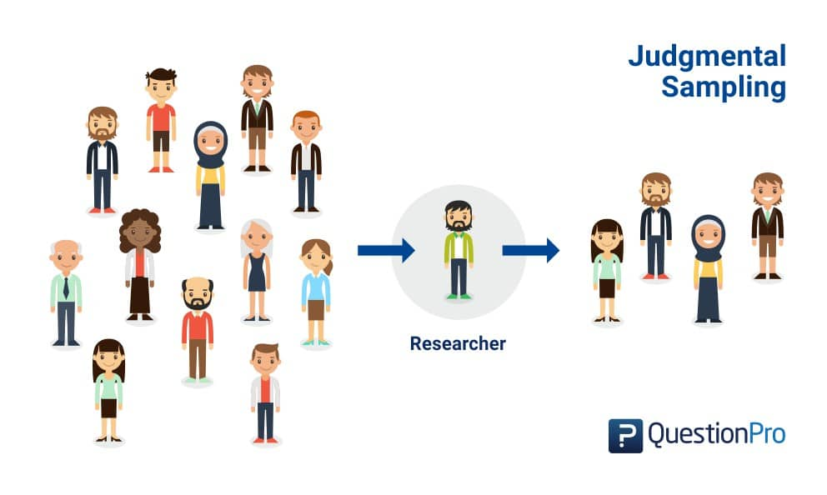
Judgment Sampling Example:

Slide 18
Quota Sampling
It is a sampling technique in which entire population is divided in to groups and then quota (no of items to be selected for research) is assigned against each group.
Groups examples: males, females, employed or unemployed people, age groups, location etc.
Once the quota is assigned to each group then sample is selected on convenience or personal judgement.

Slide 19
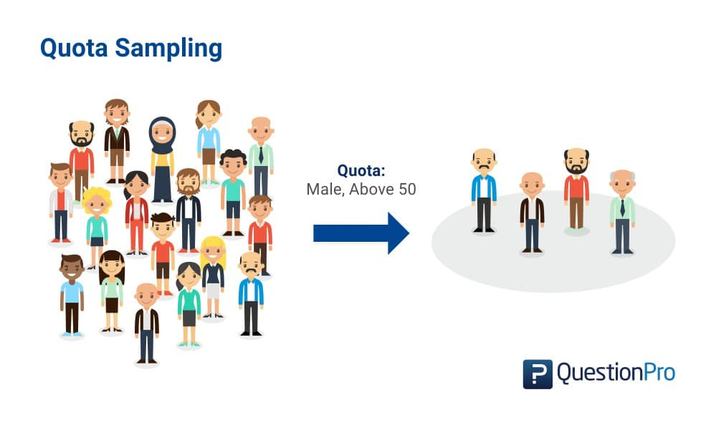
Quota Sampling Example:

Slide 20
Snowball Sampling
As the snowball moves further from top to bottom on glacier it gets bigger and bigger.
It is a sampling technique in which researcher selects one or two respondents first. These respondents refer or identify other respondents.
Researcher continuously selects respondents based on referral until required sample size is achieved.
Snowball sampling is also called referral sampling, chain sampling, network sampling, friend to friend sampling.

Slide 21
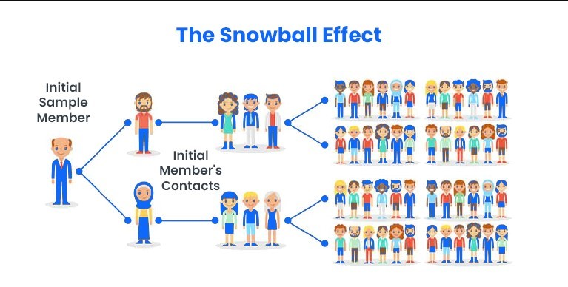
Snowball Sampling

Slide 22
THANK YOU

